Slide 1
Australian Road Fatalities
March 2023
Presented By:
Sivaiah Polagani ( U3227301 )

Slide 2
Overview
The Australian Road Deaths Database provides the state and territory road safety authorities with fundamental information regarding road transport crash fatalities that have been recorded by the police on a monthly basis. These fatalities have occurred in Australia on March 2023.
Source: https://data.gov.au/data/dataset/5b530fb8-526e-4fbf-b0f6-aa24e84e4277/resource/fd646fdc-7788-4bea-a736-e4aeb0dd09a8/download/ardd_fatalities.csv

Slide 3
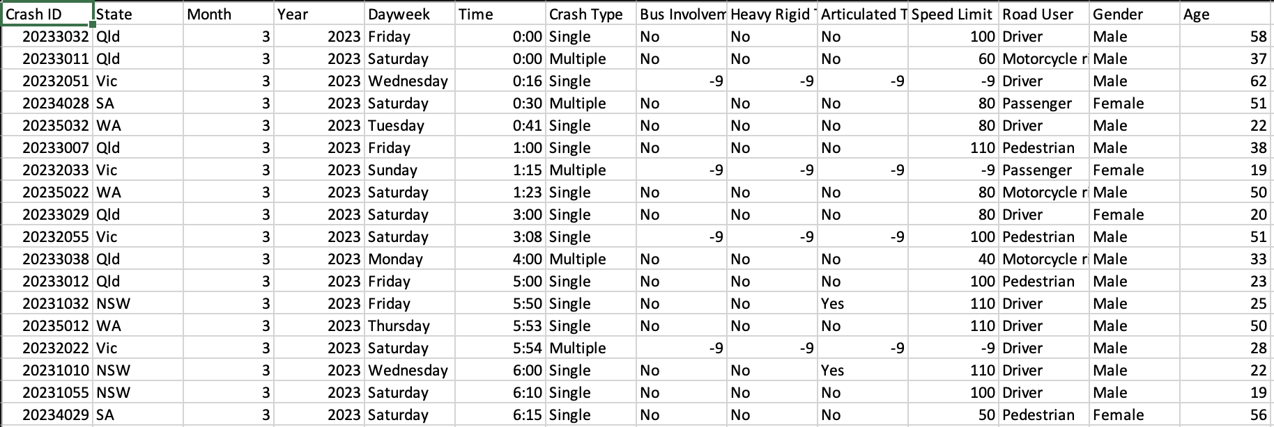
Dataset

Slide 4
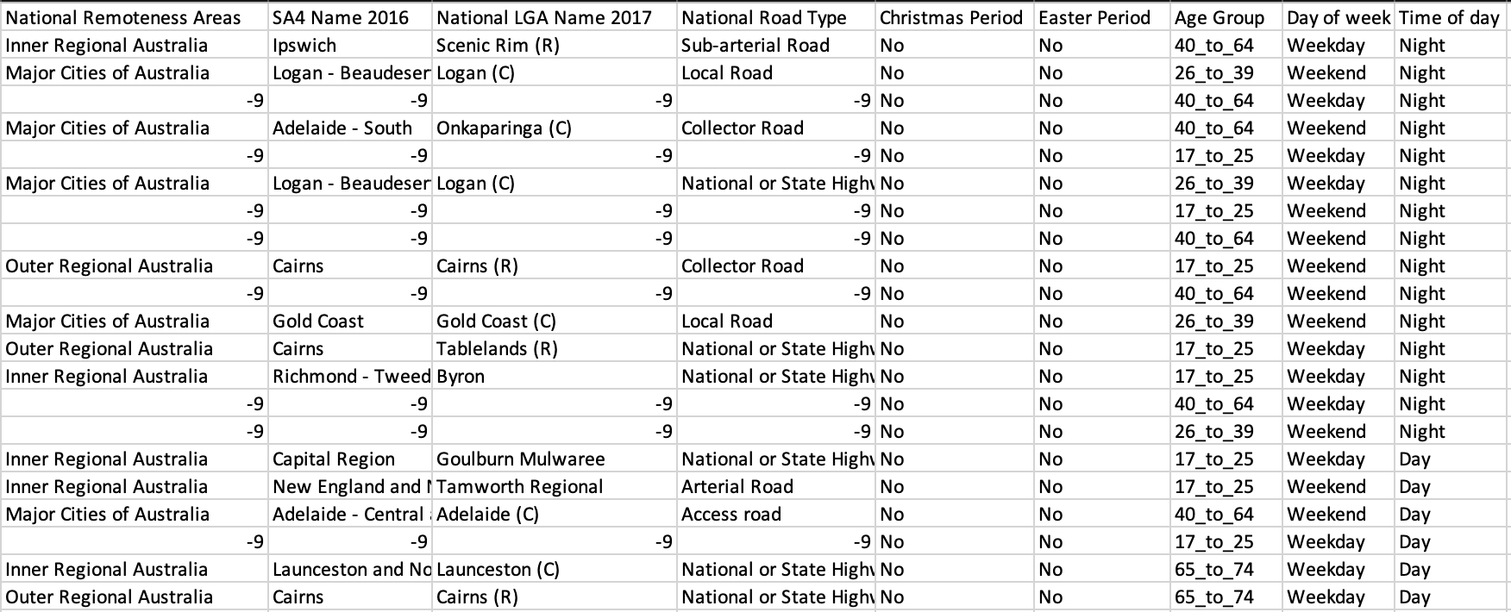
Dataset

Slide 5
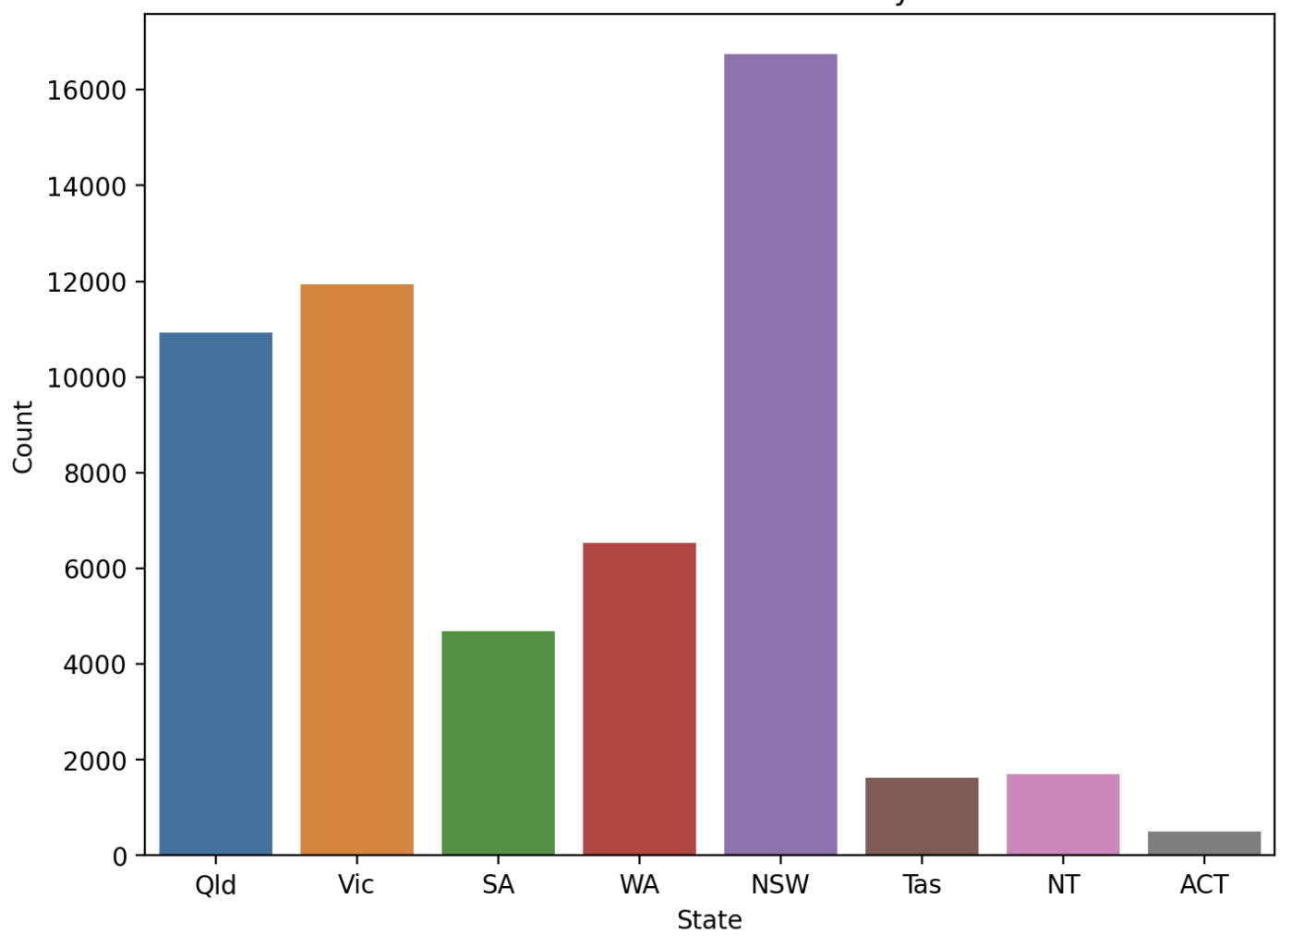
1) Distribution of Road Fatalities by State
The bar graph shows the distribution of road fatalities by state. X-Axis represents the states which are Qld, Vic, SA, WA, NSW, Tas, NT, ACT and Y-Axis represents the number of fatalities count. Moreover, this data is Australian Road Deaths Database – March 2023 data. Each state are represented by different colors. NSW is with highest fatalities and ACT with lowest fatalities.

Slide 6
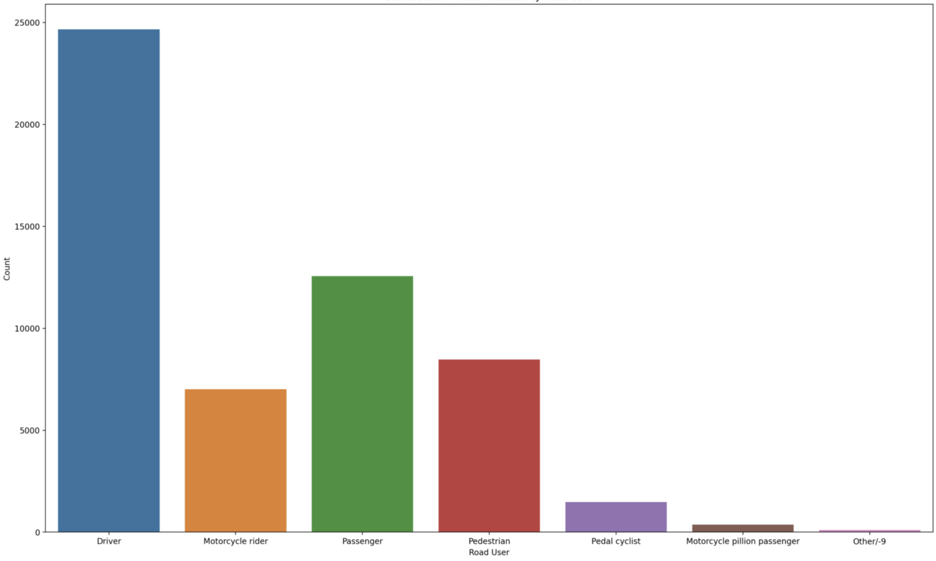
2) Distribution of Road Fatalities by Road User
The bar graph shows the distribution of road fatalities by Road User. X-Axis represents the type of road users which are Driver, Motorcycle rider, passenger, pedial cyclist and other/-9 and Y-Axis represents the number of fatalities count. Moreover, this data is Australian Road Deaths Database – March 2023 data. Each road users are represented by different colors. Driver is with highest fatalities and other/-9 with lowest fatalities. -9 represents with no data identification.

Slide 7
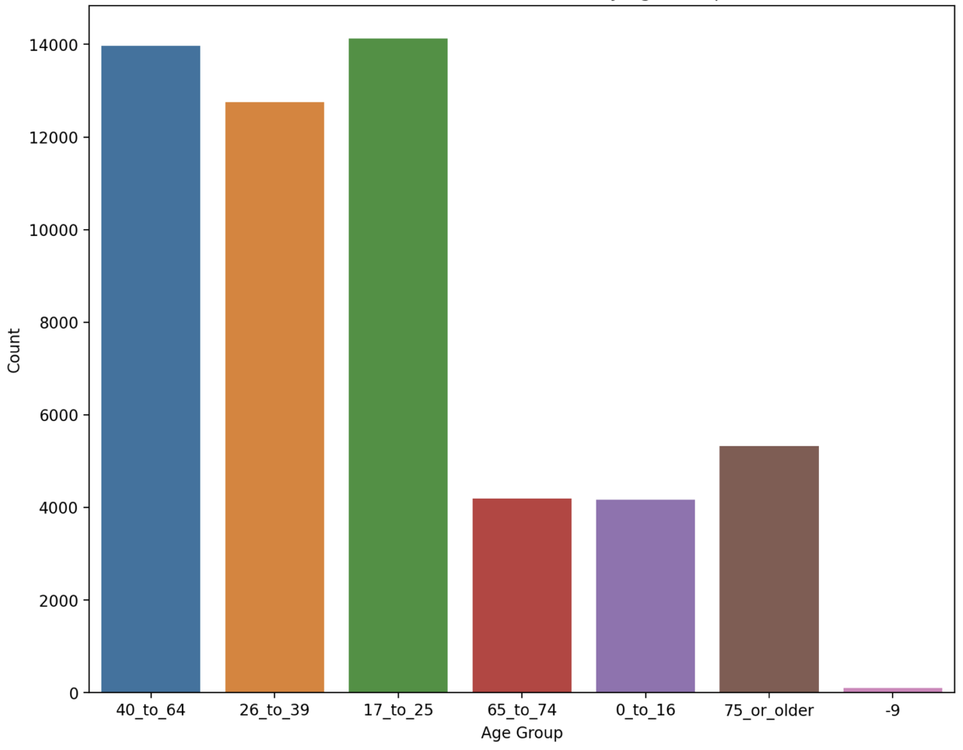
3) Distribution of Road Fatalities by Age Group
The bar graph shows the distribution of road fatalities by age group. X-Axis represents the age group which are 40-64, 26-39, 17-25, 65-74, 0-16, 75 or older, -9 and Y-Axis represents the count fatalities. Moreover, this data is Australian Road fatalities by age group – March 2023 data. Each age group are represented by different colors. 40-64 and 17-25 age group are having the highest fatalities and -9 with lowest fatalities.

Slide 8
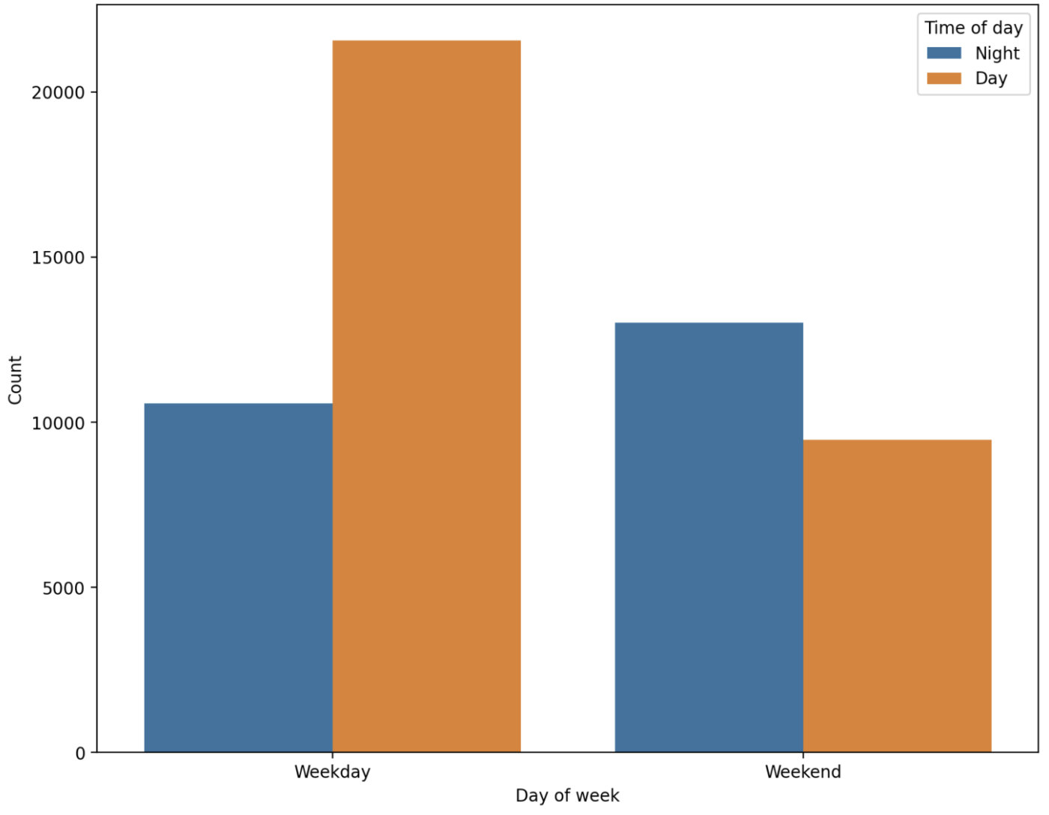
4) Comparison of Fatalities on Weekends/Weekday vs Night/Day
The bar graph shows the distribution of road fatalities by Weekends/Weekday vs Night/Day. X-Axis represents the Day of week which are Weekday – Night/Day, Weekend – Night/Day and Y-Axis represents the count fatalities. Moreover, this data is Australian Road fatalities by Day of week – March 2023 data. Each Time of day Night/Day are represented by different colors. Weekday – Day time are having the highest fatalities and – Weekend Day time with lowest fatalities.

Slide 9
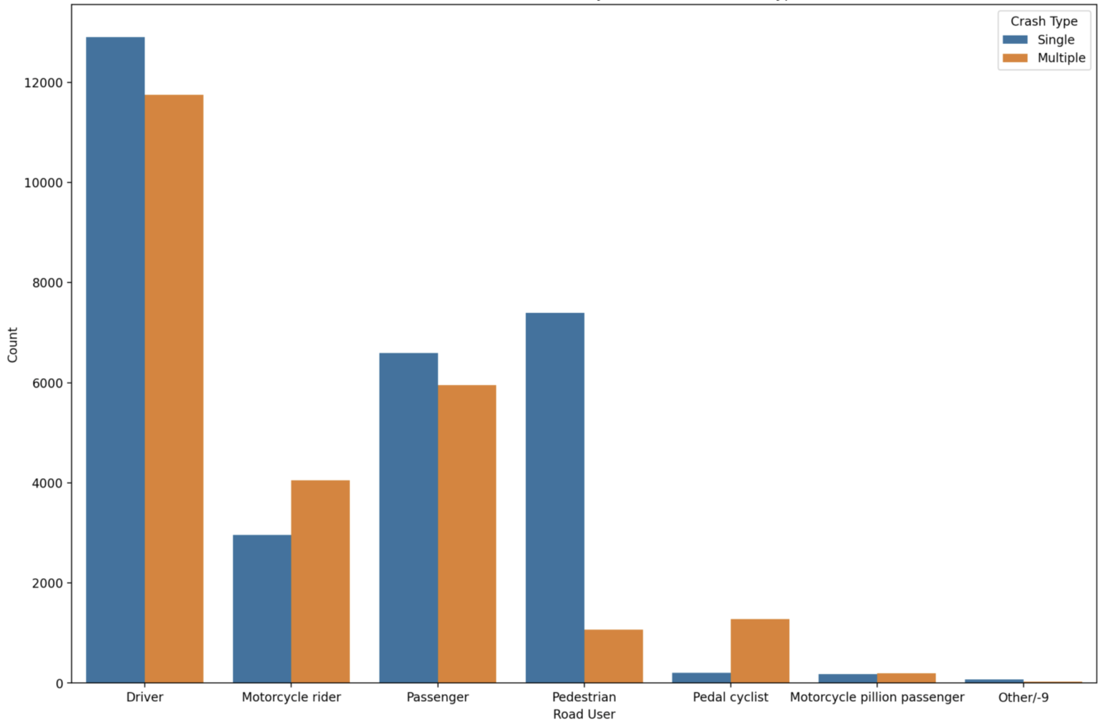
5) Comparison of Road Fatalities by Road User and Crash Type
The bar graph shows the distribution of road fatalities by Road User. X-Axis represents the Driver, Motorcycle rider, Passenger, Pedestrian, Pedal cyclist, Motorcycle pillion passenger, Other/-9 and Y-Axis represents the count fatalities. Moreover, this data is Australian Road fatalities by Crash Type – March 2023 data. Each Crash type Road user are represented by different colors. Crash type – Driver (Single, Multiple) are having the highest fatalities and – Crash Type – Others/-9 (Single, Multiple) with lowest fatalities. -9 represents the fields which does not have proper data.

Slide 10

Classification – Support Vector Machine
The target variable is 'Crash Type', while the feature variables are 'Age Group', 'Gender', 'State', 'Time of day', 'Day of the week', and 'Road User'. The categorical feature variables are then converted to numerical variables using one-hot encoding. The data are separated into training and testing collections. The training set comprises 80% of the data, while the assessment set comprises 20%. Finally, the classifier predicts the trial set's target variable to calculate the classifier's accuracy.

Slide 11
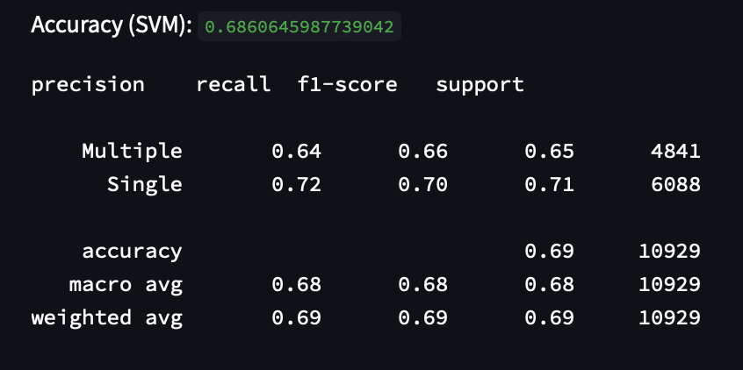
Classification – Report

Slide 12
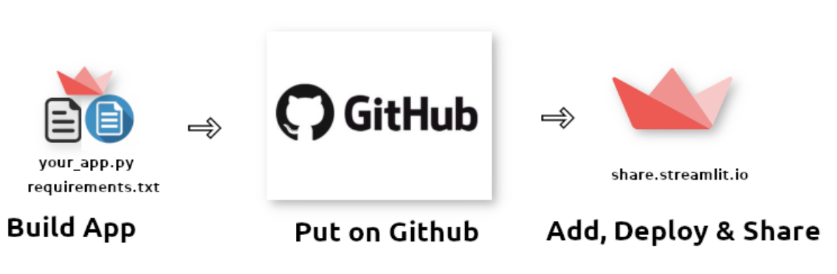
Implementation and Deployment
app.py
requirements.txt
I have implemented the capstone project to represent in GUI, I have used streamlit. This code stored in central repository of github from there I am accessing the files to deploy them in streamlit. After deploying we get an url to access, which is below. https://sivaiagpolagani-capstone-project-app-u4n3or.streamlit.app/

Slide 13
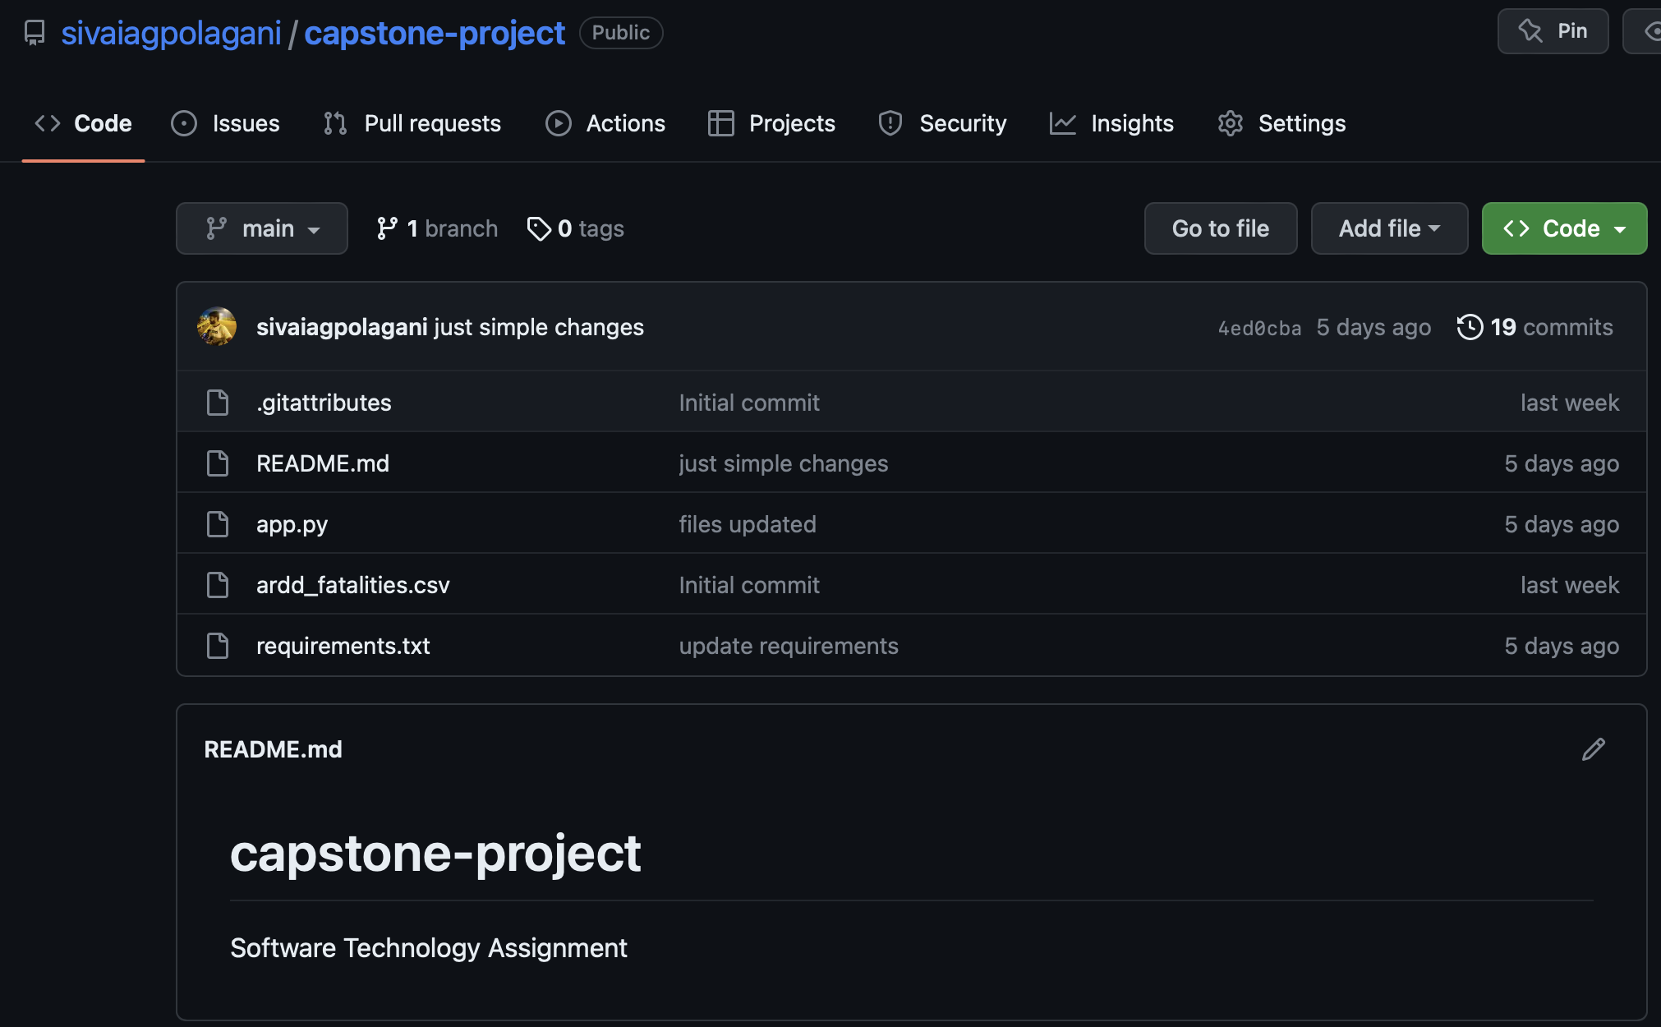
GitHub Central Repositry
app.py
requirements.txt

Slide 14
Thank You

